Slide 1
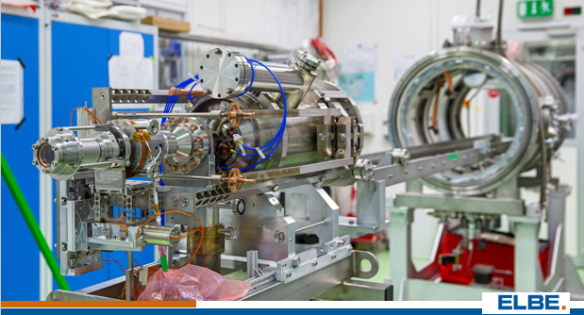
QE and life time of GaN photocathodes for SRF gun-II at HZDR
Jana Schaber on behalf of the SRF Gun Group
10/10 – 10/12/2021 P3 workshop, Online

Slide 2
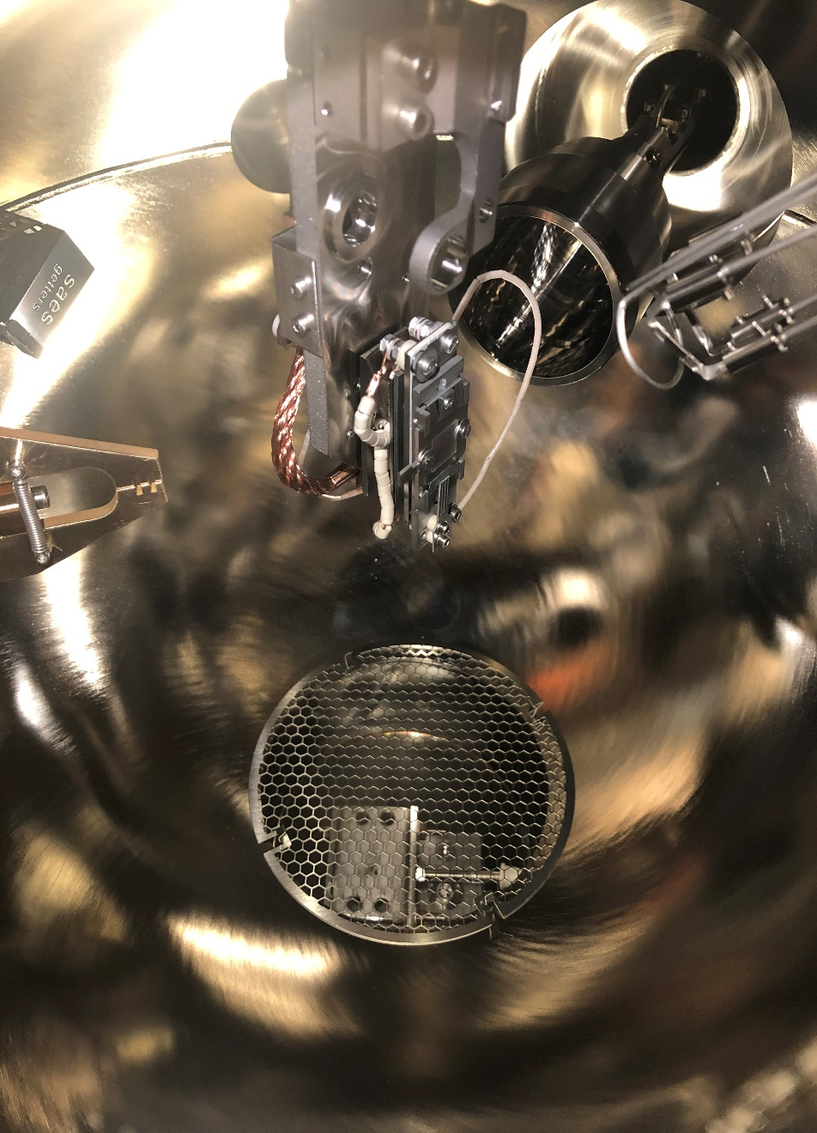
1. GaN Preparation chamber
Preparation chamber:
Manipulators
Pumps for UHV
tiltable sample
Halogen lamp
Treatment process:
1. Thermal heating
2. Cs-activation
3. QE tracking
thermal heat treatment:
clean the surface
2. activation:
produce a photocathode
3. tracking:
observe lifetime

Slide 3
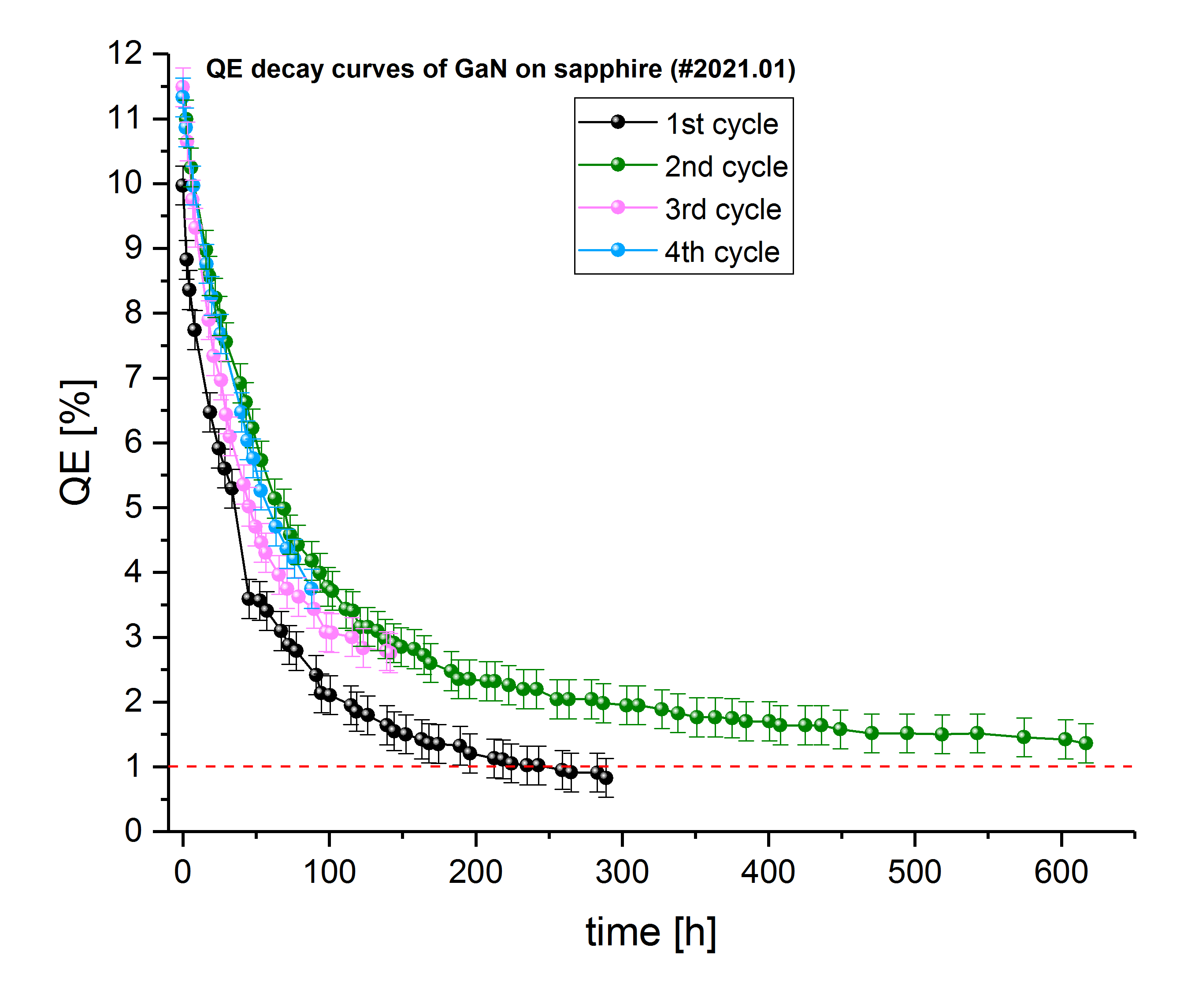
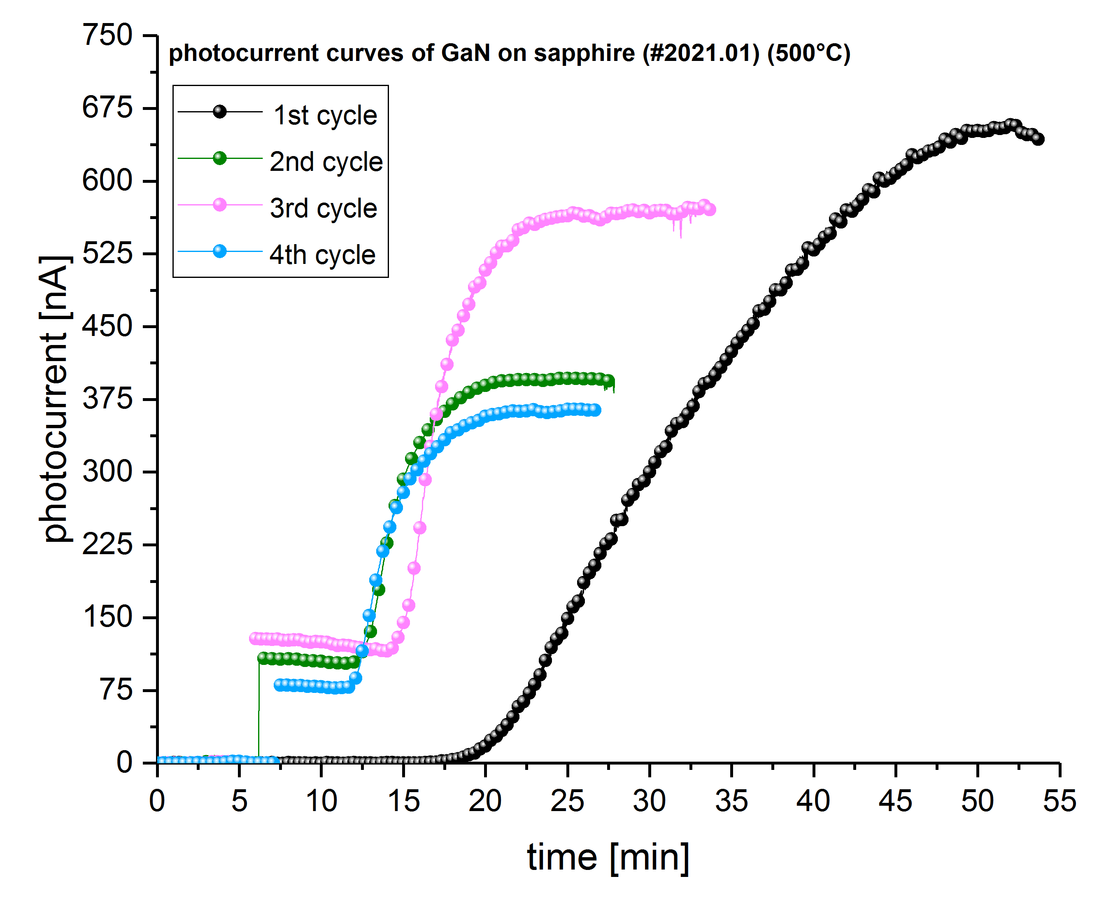
2. GaN on sapphire activation and QE tracking
1. Thermal treatment
2. Cs-activation
3. QE tracking
deposit caesium till maximum photocurrent
Re-activation can be done several times
QE decays exponentially
Re-activation leads to nearly same QE

Slide 4
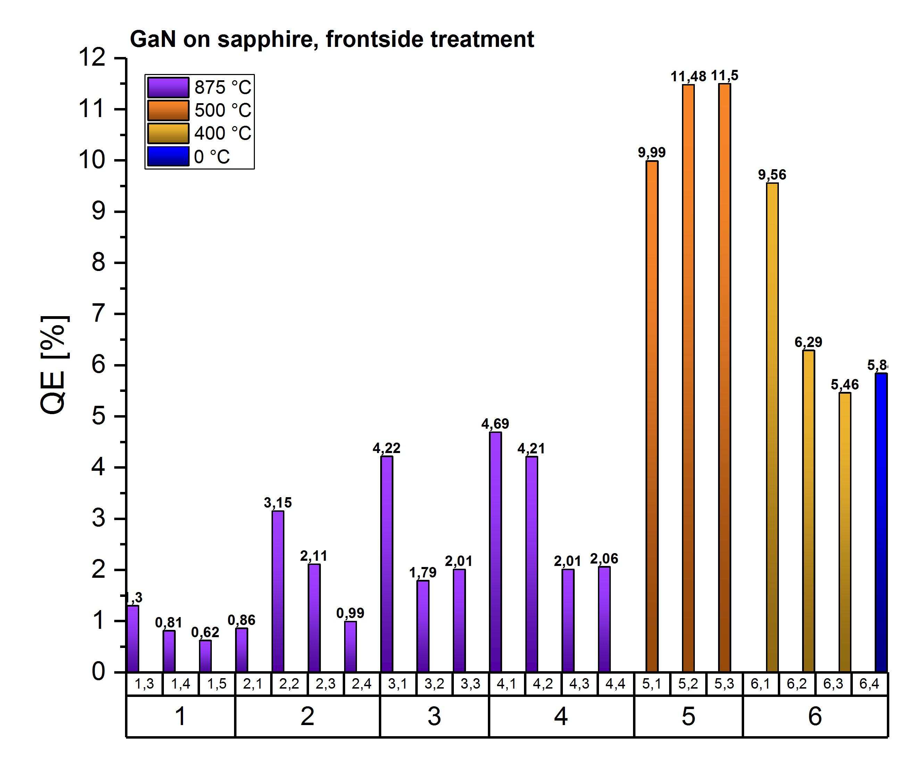
3. GaN on sapphire, QE and lifetime comparison
GaN on sapphire treated at different temperatures results in different QE values
treated with high T (875°C) leads to less QE
treated at 500°C leads to best QE (11,5%)
activation with YoYo process was tried without additional thermal heating treatment
Cs + O₂ applied alternatingly

Slide 5
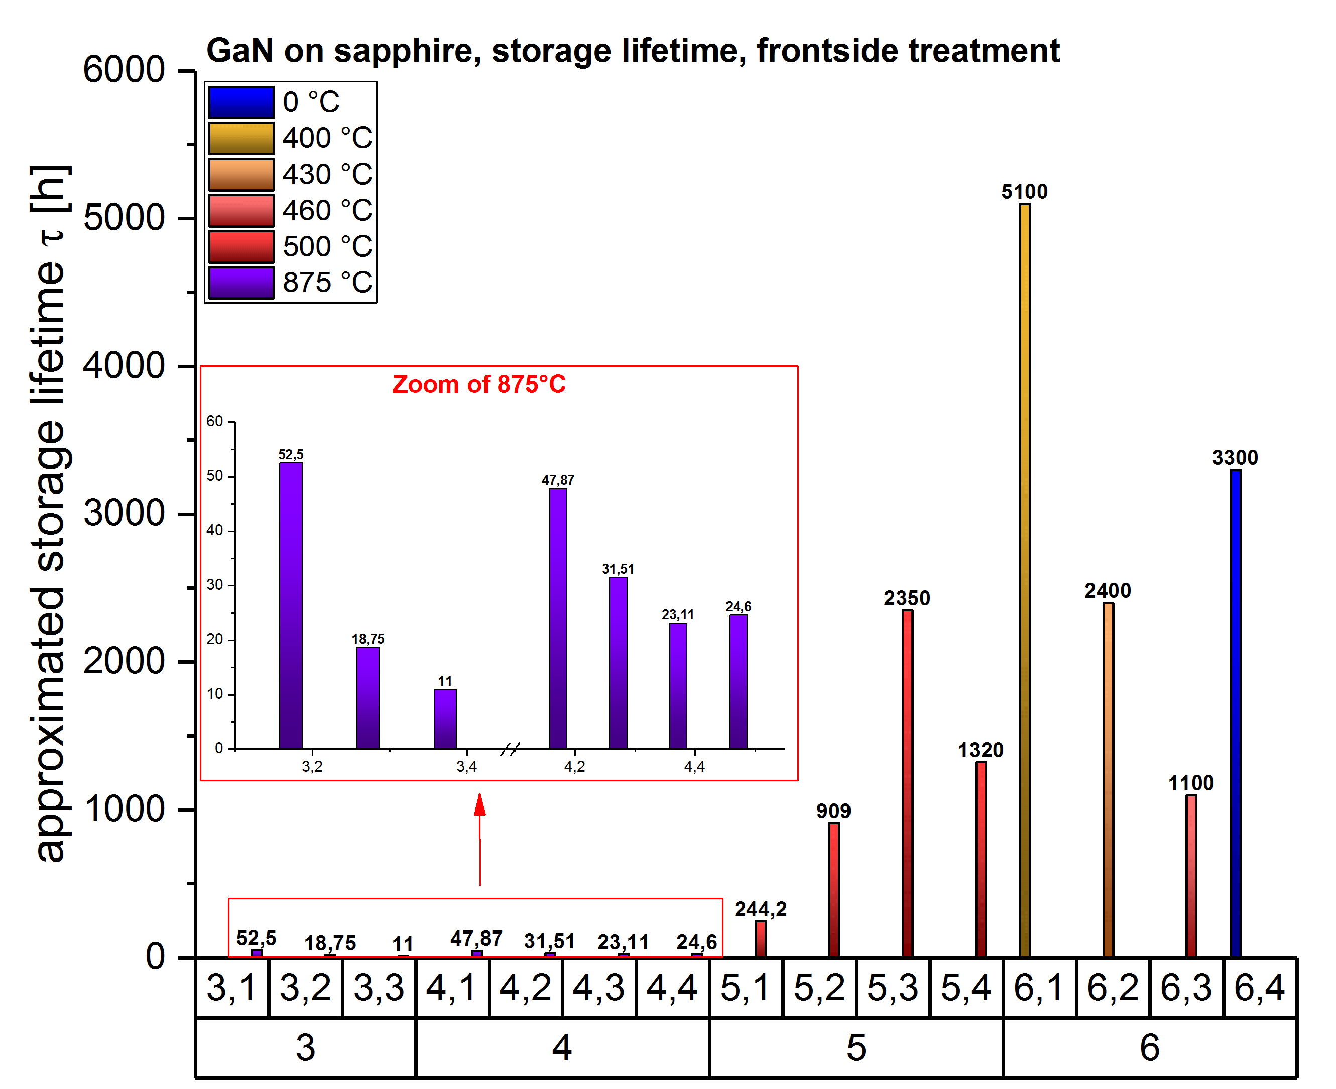
3. GaN on sapphire, QE and lifetime comparison
GaN on sapphire treated at different temperature lead to different lifetimes
Treated with high T (875°C) survive no longer than 60 h
treated at 400°C leads to best lifetime (7 months)
activation with YoYo process was tried without additional thermal heating treatment
results in good lifetime
Is a good basic to continue YoYo process study
→ Find a good compromise between highest QE long lifetime

Slide 6
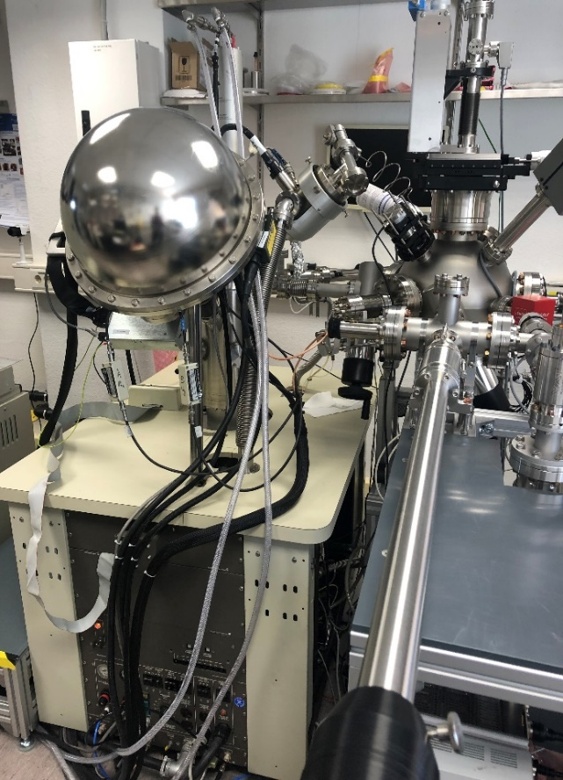
6. GaN summary and Outlook
GaN on different substrates behave different
Best result gives GaN on sapphire, cleaned at 500°C
thermal heat treatment influences QE and lifetime
Less temperature seems more beneficial
Connection to surface anlysis chamber (XPS)
To observe surface changings over lifetime or thermal heat treatment
Installation delayed 18 months !

Slide 7
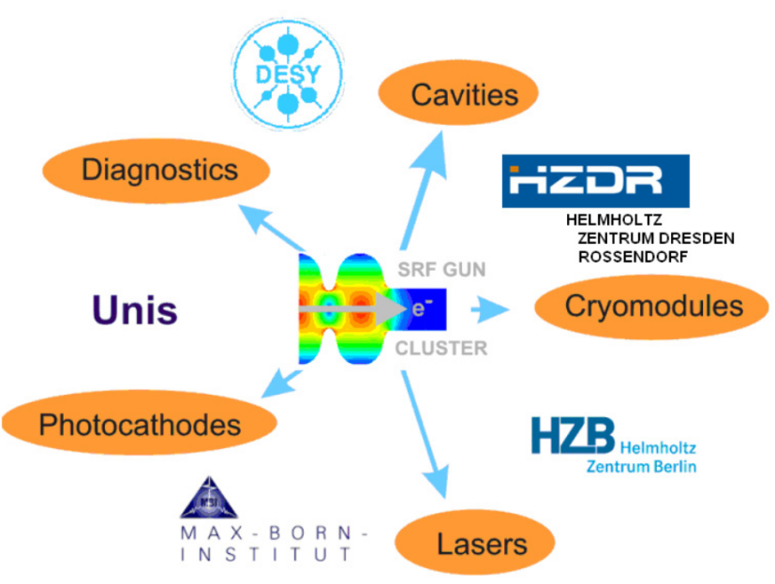
Acknowledgements
Thank you for your attention!
Thanks to the ELBE team
J.Teichert, R.Xiang, A. Arnold, P. Zwartek, S. Ma, P. Murcek, P. Evtushenko, M. Freitag, M. Justus, M. Kuntzsch, U. Lehnert, P. Michel, A. Ryzhov, C. Schneider, R. Steinbrück, K. Zenker
and our co-workers
P. Kneisel, G. Ciovati JLAB, Newport News, USA
I. Will MBI, Berlin, Germany
T. Kamps, J. Kühn, M. Schenck, M. Schmeißer, G. Klemz,
J. Voelker, HZB, Berlin, Germany
J. Sekutowicz, E. Vogel, F. Stephan, H. Qian, DESY, Germany
K. Aulenbacher, JGU, Mainz, Germany
M. Vogel, X. Jiang, Uni Siegen, Germany
R. Nietubyć NCBJ, Świerk/Otwock, Poland
U. van Rieken, E. T. Tulu, Uni Rostock, Germany

Slide 8
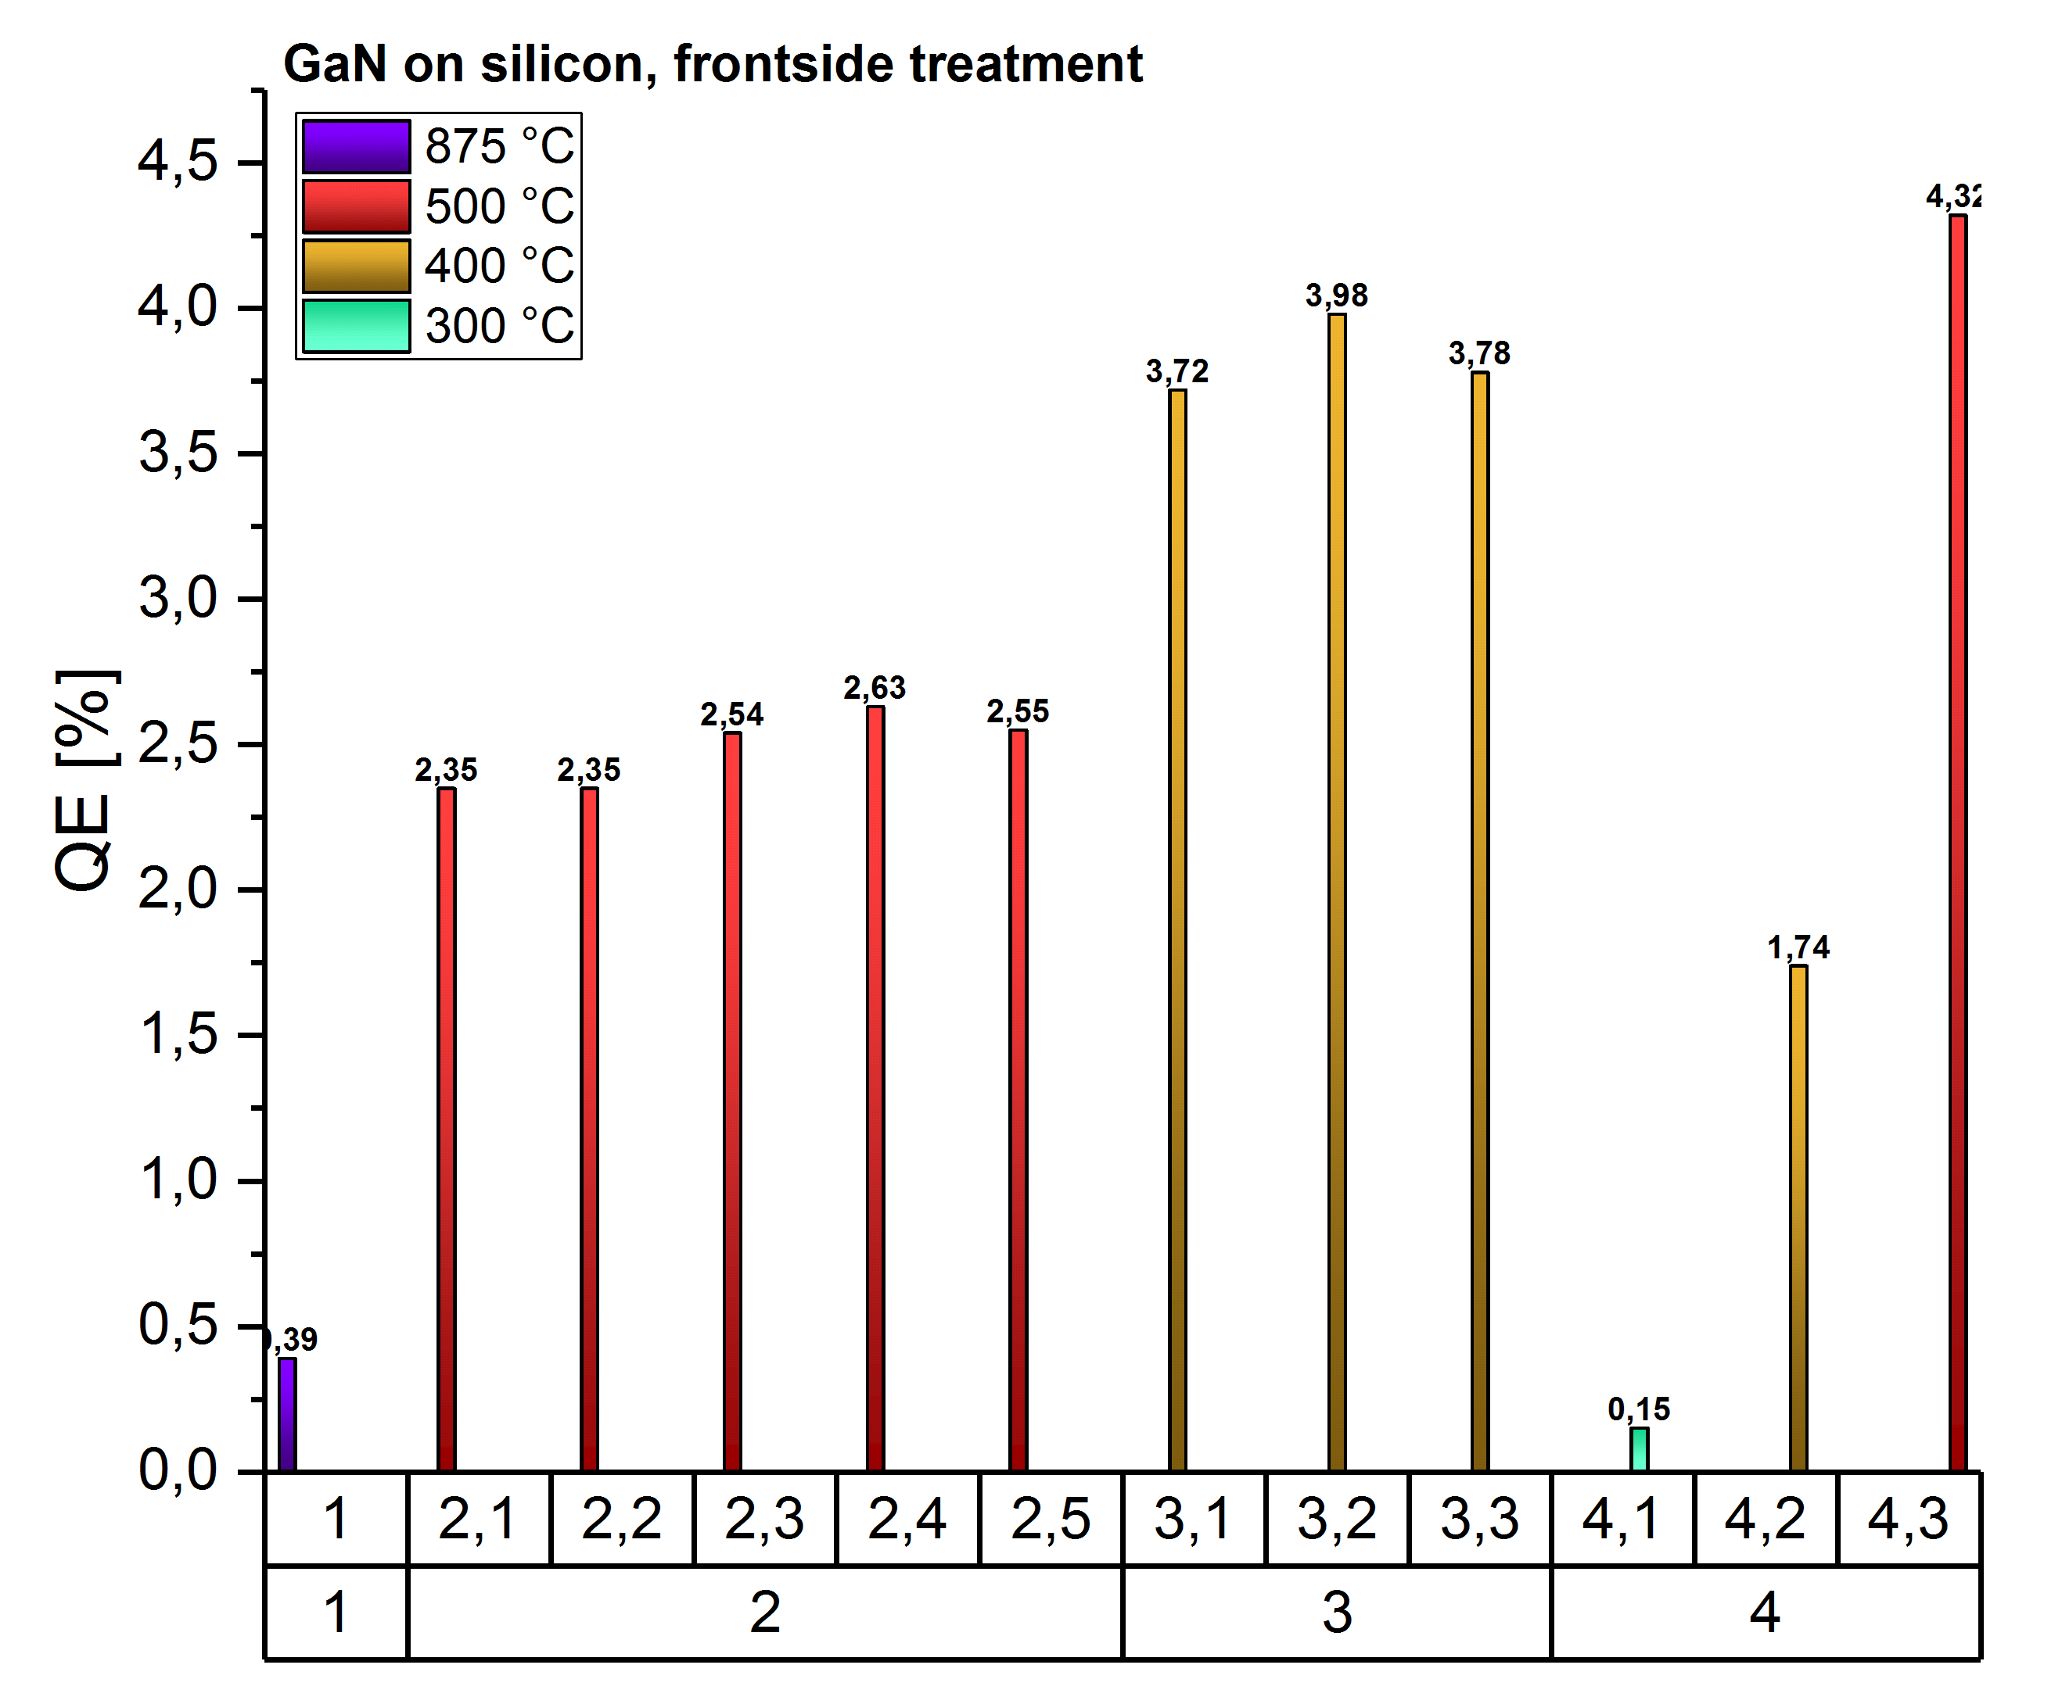
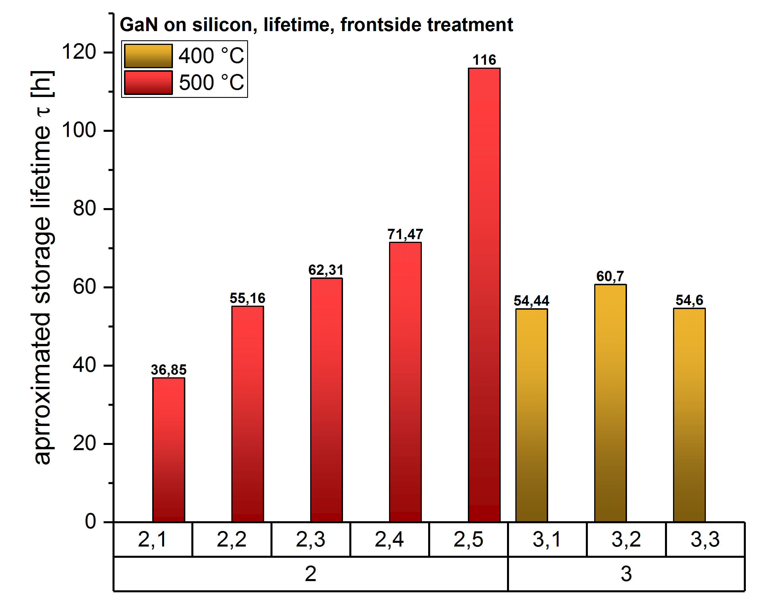
3. GaN on Si, QE and lifetime comparison

